Slide 1
3D Image Segmentation and Quantification of Lysosomes
4/12/2025

Slide 2
LAST MEETING
My progress these last few weeks:
Checked the size.
Included additional metrics such as mean and standard deviation.
Comparison MANUAL.vs.AUTOMATIC.
Now the script can assign serial order numbers to lysosome and cell IDs.
Review possible over-detection in some images.
I am working in the automatization of same parameters to avoid or reduce over deteccion on all images.
Verify cases where there are lysosomes outside with a different cell ID.
I will start working on this point next week.
OREN: One addition/clarification - need to find a way to limit cell size to a certain (lower) limit so to exclude these fragments being counted as a cell…

Slide 3
FILES
Airy scan_40A_UAS-TMEM-HA_CB_0h_1_051222
Airy scan_40A_UAS-TMEM-HA_CB_0h_2_051222
Airy scan_40A_UAS-TMEM-HA_CB_4h_1_051222
Airy scan_40A_UAS-TMEM-HA_CB_4h_2_051222
TMEM-HA 6h CB airy_3_170722
40A_UAS-TMEM192-3xHA x 40A 71G10 MARCM_around 12h - for quantification_4 Airy-CBs_300425
40A_UAS-TMEM192-3xHA x 40A 71G10 MARCM_around 12h - for quantification_3 Airy-CBs_300425
40A_UAS-TMEM1923x-HA x 71G10 40A MARCM_L3_2_Airy_010724
40A_UAS-TMEM1923x-HA x 71G10 40A MARCM_L3_1_Airy_010724

Slide 4
Airy scan_40A_UAS-TMEM-HA_CB_0h_1_051222

Slide 5
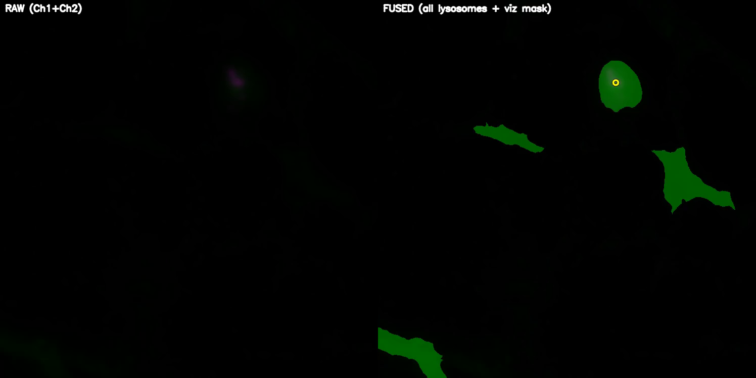
DETECTION VIDEO

Slide 6
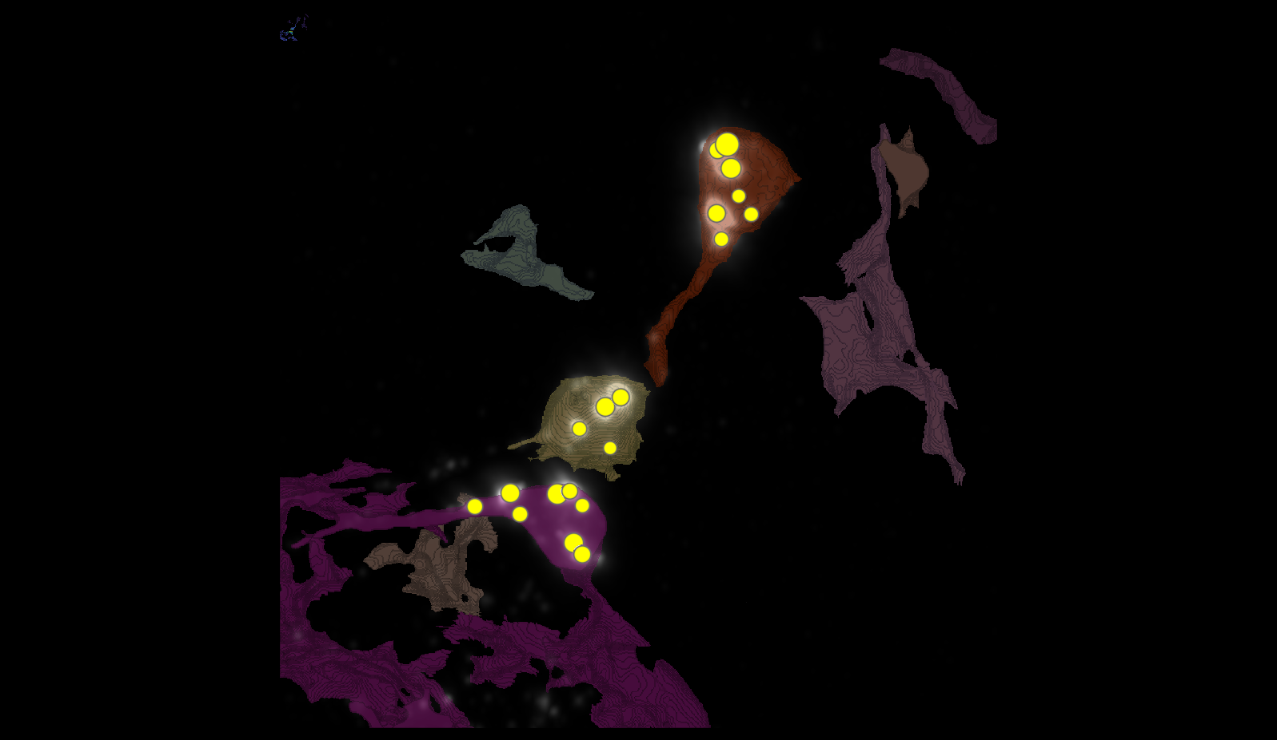
SEGMENTATION

Slide 7
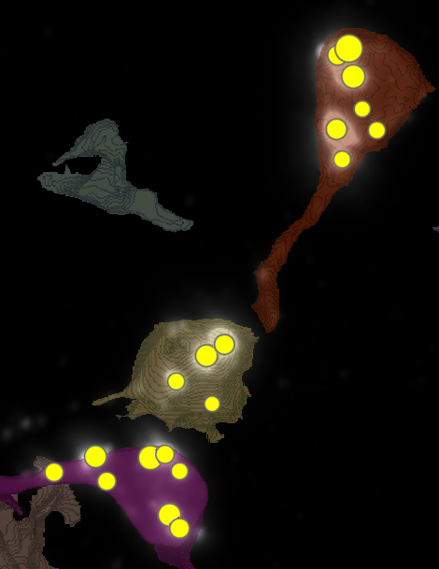
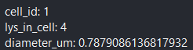
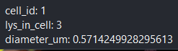
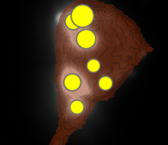
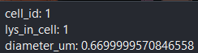
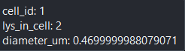
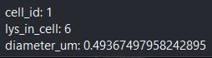
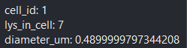
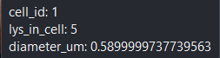
METRICS
1
6
4

Slide 8
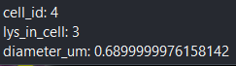
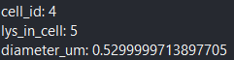
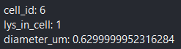
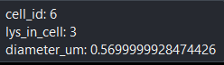
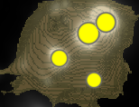
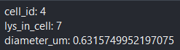
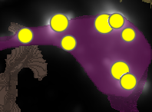
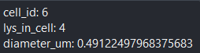
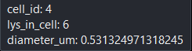
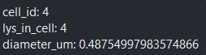
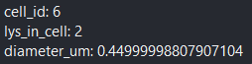
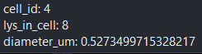
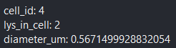
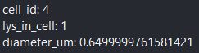
METRICS

Slide 9
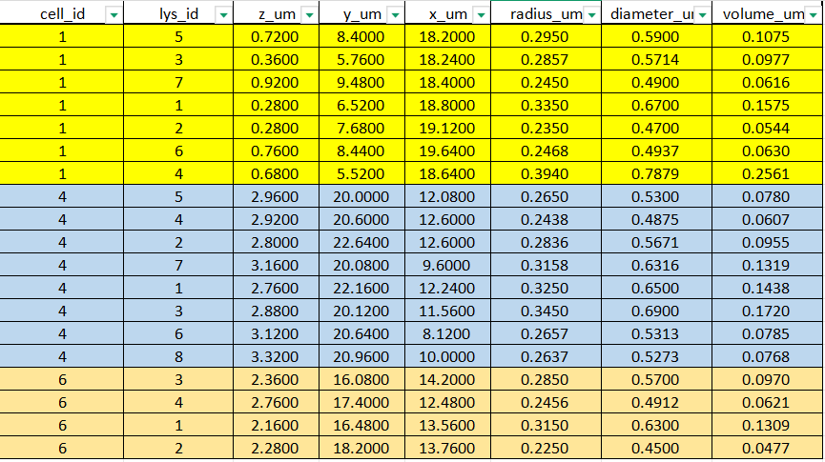
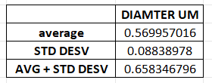
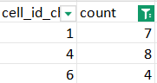
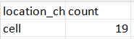
DATASETS

Slide 10
Airy scan_40A_UAS-TMEM-HA_CB_0h_2_051222

Slide 11
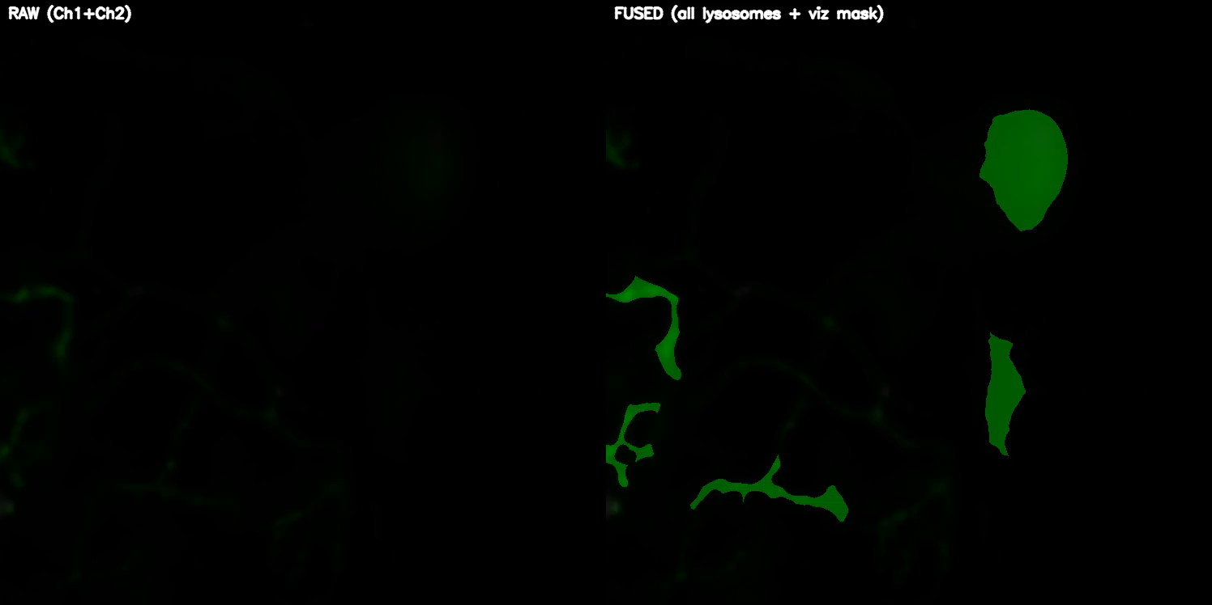
DETECTION VIDEO

Slide 12
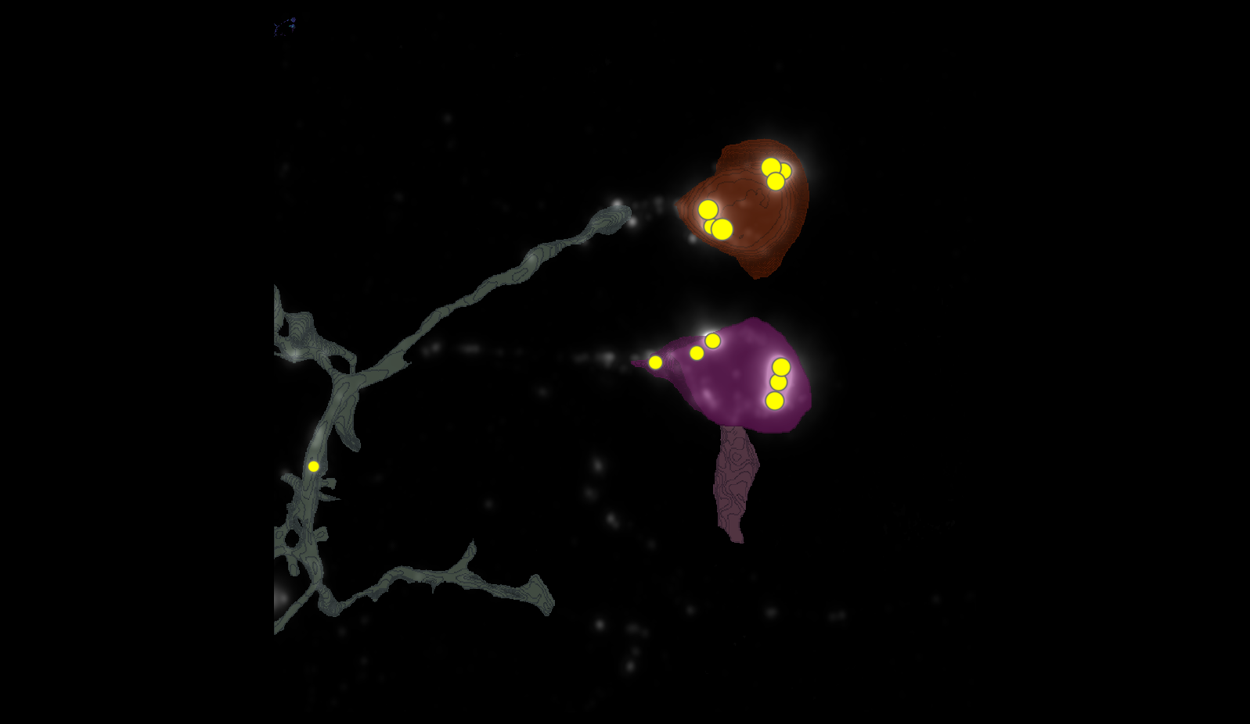
SEGMENTATION
1
4
2
3

Slide 13
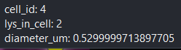
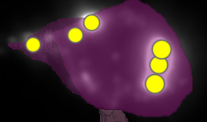
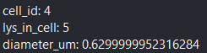

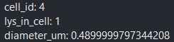
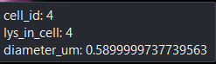
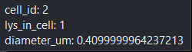
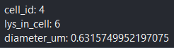
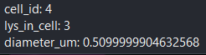
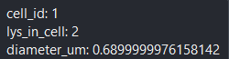
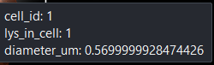
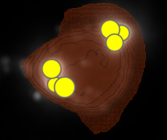
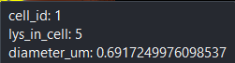
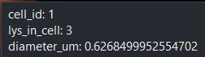
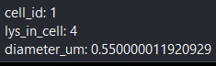
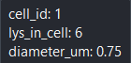
METRICS

Slide 14
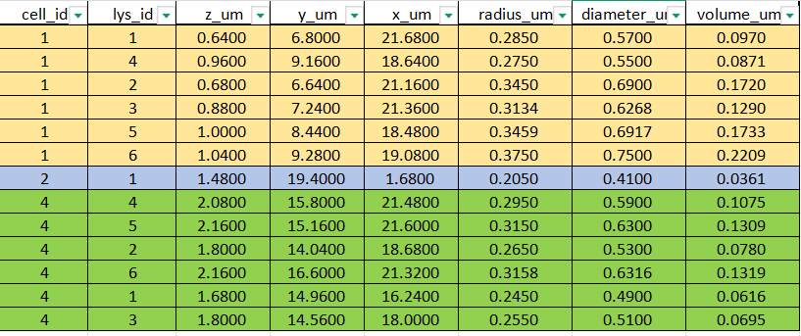
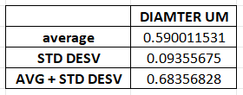
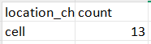
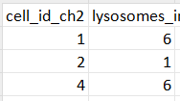
DATASETS

Slide 15
Airy scan_40A_UAS-TMEM-HA_CB_4h_1_051222

Slide 16

DETECTION VIDEO

Slide 17

SEGMENTATION
4
5
2
3

Slide 18


























METRICS

Slide 19




DATASETS

Slide 20
Airy scan_40A_UAS-TMEM-HA_CB_4h_2_051222

Slide 21
DETECTION VIDEO

Slide 22
SEGMENTATION

Slide 23
METRICS

Slide 24
DATASETS

Slide 25

TMEM-HA 6h CB airy_3_170722

Slide 26

TMEM-HA 6h CB airy_3_170722

Slide 27







































TMEM-HA 6h CB airy_3_170722

Slide 28






















TMEM-HA 6h CB airy_3_170722

Slide 29


























TMEM-HA 6h CB airy_3_170722

Slide 30





TMEM-HA 6h CB airy_3_170722

Slide 31

40A_UAS-TMEM192-3xHA x 40A 71G10 MARCM_around 12h - for quantification_4 Airy-CBs_300425

Slide 32

40A_UAS-TMEM192-3xHA x 40A 71G10 MARCM_around 12h - for quantification_4 Airy-CBs_300425
lys_id:2
lys_id:1
lys_id:3

Slide 33




40A_UAS-TMEM192-3xHA x 40A 71G10 MARCM_around 12h - for quantification_4 Airy-CBs_300425

Slide 34

40A_UAS-TMEM192-3xHA x 40A 71G10 MARCM_around 12h - for quantification_3 Airy-CBs_300425

Slide 35

40A_UAS-TMEM192-3xHA x 40A 71G10 MARCM_around 12h - for quantification_3 Airy-CBs_300425

Slide 36





















40A_UAS-TMEM192-3xHA x 40A 71G10 MARCM_around 12h - for quantification_3 Airy-CBs_300425

Slide 37




40A_UAS-TMEM192-3xHA x 40A 71G10 MARCM_around 12h - for quantification_3 Airy-CBs_300425

Slide 38

40A_UAS-TMEM1923x-HA x 71G10 40A MARCM_L3_1_Airy_010724

Slide 39

40A_UAS-TMEM1923x-HA x 71G10 40A MARCM_L3_1_Airy_010724

Slide 40

























40A_UAS-TMEM1923x-HA x 71G10 40A MARCM_L3_1_Airy_010724

Slide 41




40A_UAS-TMEM1923x-HA x 71G10 40A MARCM_L3_1_Airy_010724

Slide 42




40A_UAS-TMEM1923x-HA x 71G10 40A MARCM_L3_1_Airy_010724

Slide 43

40A_UAS-TMEM1923x-HA x 71G10 40A MARCM_L3_2_Airy_010724
28
96
45
2
85
95

Slide 44





40A_UAS-TMEM1923x-HA x 71G10 40A MARCM_L3_2_Airy_010724
cell | automatic | manual
2 | 39 | NOT DATA
28 | 23 | 20
45 | 32 | 15
85 | 10 | 12
95 | 22 | 20
96 | 24 | 25

